Slide 1
OMS-DPM: Optimizing the Model Schedule for
Diffusion Probabilistic Models
Muyan Hu, Xin Xu, Jiachen Yuan

Slide 2
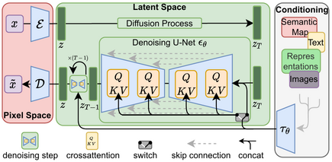
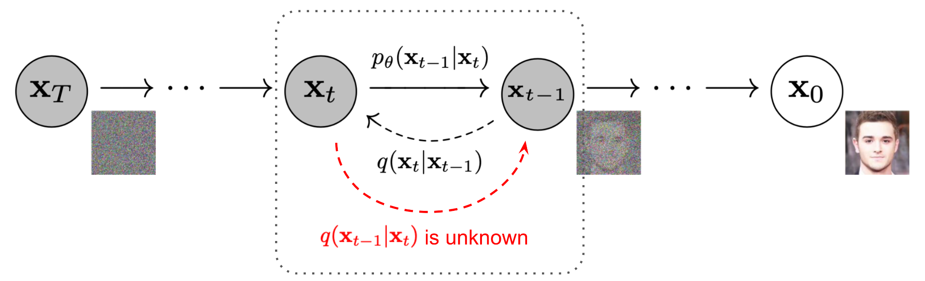
Background
Diffusion Model:
Training: adding Gaussian noise to images and predicting the noise;
Generation (DDPM): starting with Gaussian noise, and removing noise iteratively.
Stable Diffusion: Run the diffusion process in the latent space instead of pixel space.
Notes:
<say something to lead to review some diffusion concepts> In a diffusion model, the training phase involves adding Gaussian noise to images and learning to predict this noise at every timestep from x0 to xT. During generation, as in Denoising Diffusion Probabilistic Models (DDPM) as the simplest sampler as an example, the process starts with an image full of Gaussian noise, and noise is iteratively and gradually removed by using the trained model to predict the noise and subtract that noise from the image at each step backward from xT to x0.
The famous Stable Diffusion extends this approach by running the diffusion process in a more efficient latent space rather than directly in pixel space. This method leverages a U-Net architecture in latent space, conditioned on various inputs like text or semantic maps, to produce high-quality images more efficiently.

Slide 3
Background
Ways to speed up generation: training-free samplers, consistency model, …
Training-free samplers:
DDIM: Image generation with fewer steps.
DPM-Solver: Utilizes high-order information to solve the diffusion ODEs.
Is there potential for speed-up outside of the sampler design?
Notes:
Because of the sequential and iterative nature of the generation phase, there is a great interest in how to accelerate it while maintaining good output image quality. There are many existing approaches and optimizations at the algorithm level like training-free samplers, consistency models, and so on. For example, we have DDIM, which improves upon DDPM by reducing the number of steps in the generation. Also, we have DPM-Solver, which models the generation as ODEs and uses high-order information to generate an image with fewer steps without losing quality.
This paper addresses the problem in a different angle and it asks this question: “Is there potential for speed-up outside of sampler design”?

Slide 4
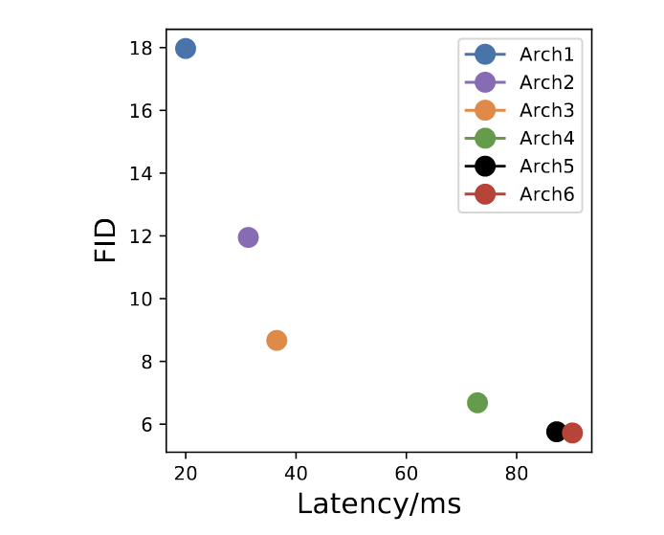
Observations
As expected: Using a single network with smaller latency across all steps leads to worse sample quality due to the lower model capacity.
Notes:
The authors’ insights and intuition are built upon a series of experiments and observations. First of all, they took various models of different sizes that are pretrained on CIFAR-10 dataset and generate 10k images using a 90-step DPM-Solver with batch size = 128 on single A100 GPU. The quality and the speed of these models are what’s important and shown in the diagram on the left. The vertical axis is the FID score. FID is a similarity score that is usually used to compare two datasets. In this paper, the FID score of a model is always calculated between the set of generated images by the model and the reference dataset. Following this paper’s logic, the lower the FID of a model, the better the generation quality. The horizontal axis shows the latency of one denoising step of the models, which represents the size of a diffusion model.
In the figure, we can see as the model size increases (which means the latency increases), the generation quality also increases. The figure shows an unsurprising fact that “Using a single network with smaller latency across all steps leads to worse sample quality due to the lower model capacity”.

Slide 5
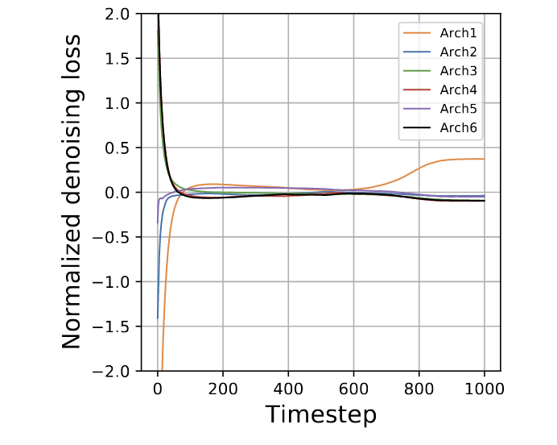
Observations
Observation #1: The ranking of denoising abilities is inconsistent across steps.
Observation #2: Small models can outperform large models in a wide range of steps in terms of denoising loss.
Notes:
The second experiment is to record down the denoising losses of each model at each timestep on the CIFAR-10 test set. The figure on the left plots the denoising loss curves w.r.t. Timesteps for all the models.
Looking at the figure on the left, one key observation is that the ranking of denoising abilities of the models is inconsistent across steps.
And, small models can actually outperform large models in a wide range of steps in terms of denoising loss: Arch 6 is larger than Arch 1, but has higher denoising loss on 0-50 timesteps.
Although empirically denoising loss != quality, but this phenomenon makes the author wonder why not try mixing various models to see whether quality degrades.

Slide 6
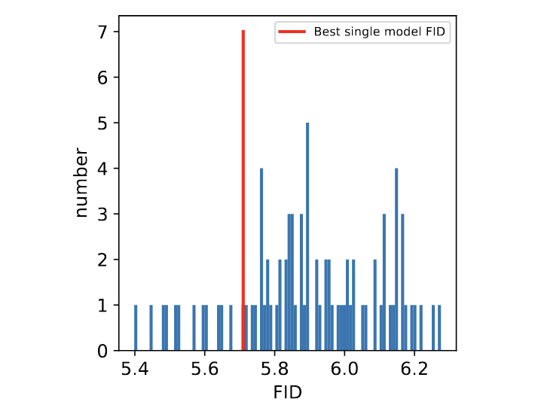
Observations
Observation #3: Randomly selecting pretrained models at different denoising steps can create mixed models that outperform the best model in terms of both quality and speed.
The red line indicates the best FID achieved by a single model in the model zoo.
Notes:
So by randomly mixing the models at different denoising steps, the authors found that there are many such combined models that can outperform the best single e2e model in terms of FID.
The figure on the left is a histogram of FID achieved by a set of models including both single model and combined/mixed models. The red line indicates the best FID achieved by a single model e2e is around 5.7 (we know that model is probably the largest pretrained model because the first experiment tells that the generation quality is positively related to the model size), but there are many mixed model having lower FID (circled in the figure). The best mixed model can achieve 5.4 FID score. Since the mixed model is derived by substituting the large model with smaller models at various timesteps, the e2e inference latency of the best mixed model is also lower than the best single model marked by the red line.

Slide 7
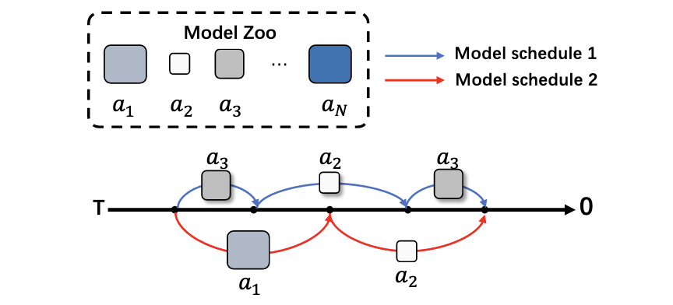
Insights and Overall Ideas
Intuition: favor using small models for certain denoising steps.
Given a set of pre-trained models, how to find the model schedule to achieve the best trade-off between generation quality and latency?
Brute-force search seems impossible.
A greedy algorithm does not work well.
Notes:
Last observation is very promising because the mixing models in this experiment are randomly composed, which infers that a crafted mixed diffusion model might have a large probability of outperforming any single best model in terms of both quality and speed.
So the intuition is to favor using small models for certain denoising steps. The research question is then “Given a set of pre-trained models, how to find the model schedule (the model assignments to each of the denoising steps) to achieve the best trade-off between generation quality and latency?”
Challenges:
Exponential number of permutations
Greedily choosing model with lowest denoising loss at each step might not yield best image quality from an e2e perspective.

Slide 8
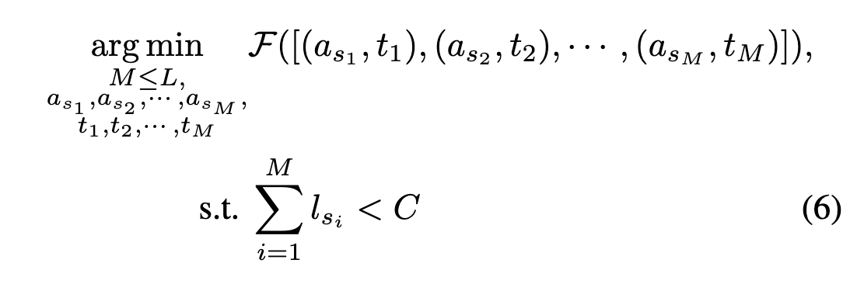
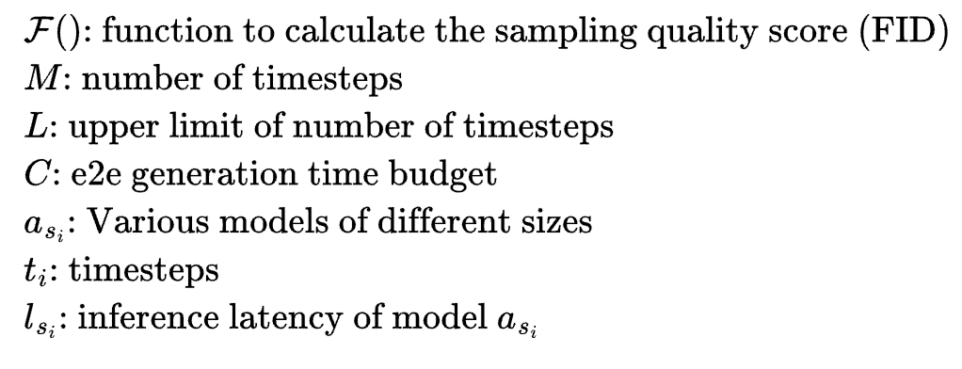
Problem Formulation
Introduce a special null model a0 to allow skipping timesteps.
Notes:
To more formally define the problem, the authors wrote it in terms of an optimization problem. The optimization problem tries to find the best model assignments for each timestep to achieve the minimum FID while satisfying the overall e2e generation latency requirement. In order to allow skipping timesteps, the authors also introduce a special null model a0. For example, if a0 is assigned to a step tx, it means that tx is skipped without any denoising.
Note that this introduction of a0 again expands the search space of schedules, so it is quite impossible to find a closed-form solution to this problem.

Slide 9
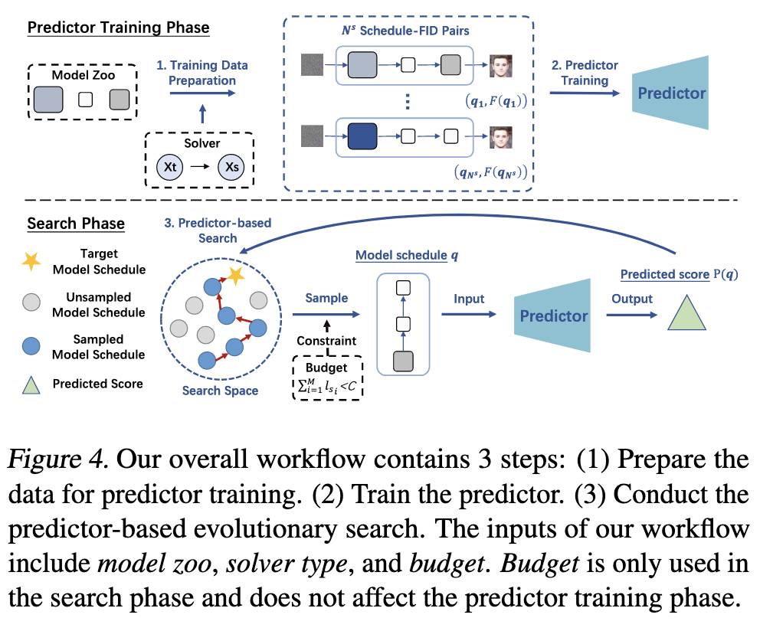
Approach Overview
Notes:
This is why the authors resort to a machine learning-based approach called Predictor-based model schedule optimization.
For each dataset, finding the optimal model schedule takes 3 steps.
Predictor Training Phase
Training Data Preparation
Predictor Training
Search Phase
Predictor-based Search

Slide 10
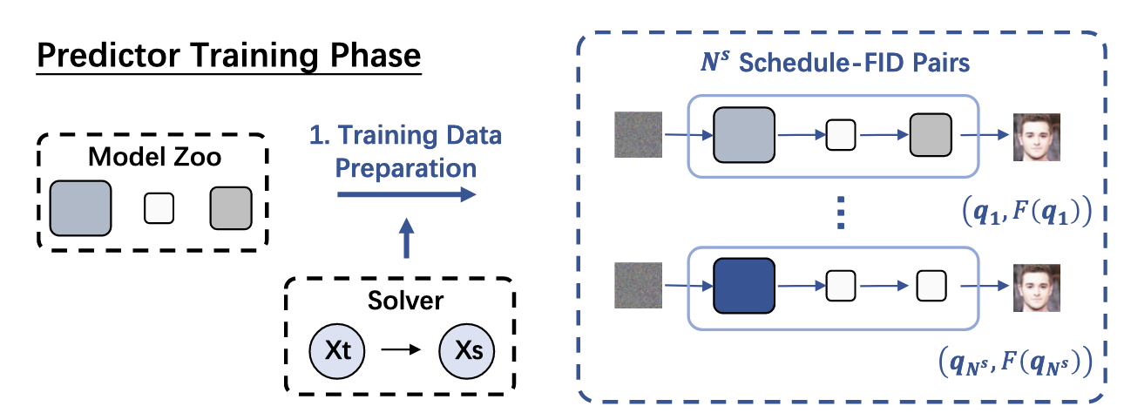
Training Data Preparation
Randomly sample N schedules from the model zoo.
Evaluate FID scores for each schedule to get Schedule-FID pairs.
Use multiple multinomial distributions to make data diverse enough.
Notes:
In the training data preparation step, N model schedules are randomly sampled given the model zoo (a set of pretrained models). Each schedule is evaluated using a solver depending on the sampler type and assigned an FID score using relatively small number of images.
After that, we have generated our data and labels, namely the Schedule-FID pairs that will be used to train a predictor model.
One thing to note is that, as mentioned earlier there are exponential number of possible schedules, so it is not possible to gather all schedules in the training dataset. We want our selected N schedules to be diverse enough so that after training the predictor model will have better generalizability on unseen schedules. The authors achieves this by manually assign multinomial distribution weights to the sampling process.

Slide 11
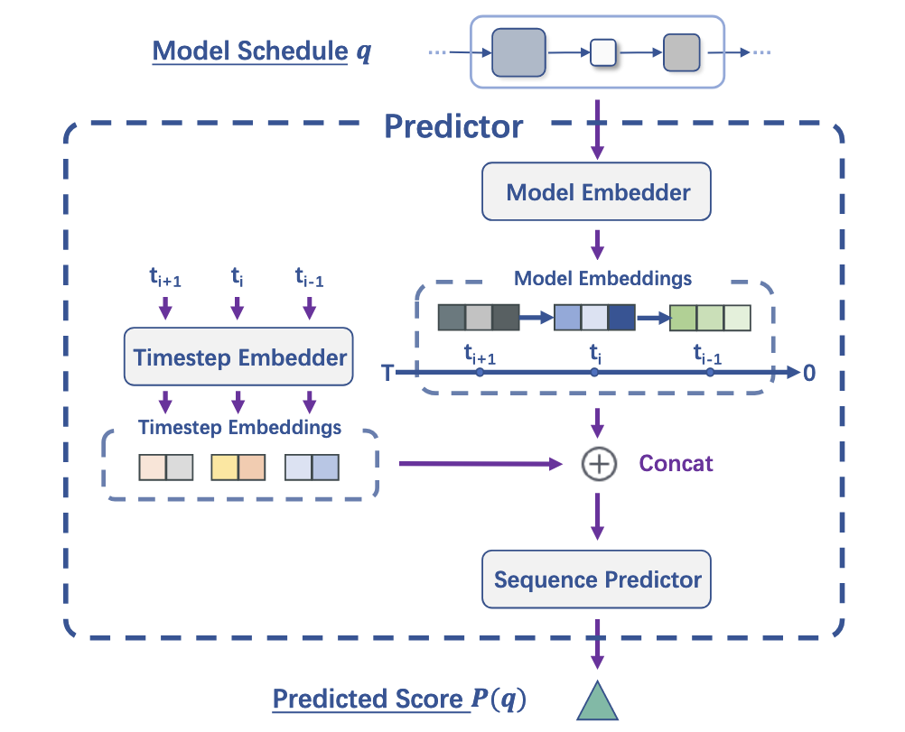
Predictor Architecture
Model Embedder
Each model choice si is projected into a d-dimensional vector for each timestep.
Timestep Embedder
Each timestep ti is converted to a sinusoidal embedding vector and then projected into a d-dimensional vector.
Sequence Predictor
concat(embeddings) ->LSTM->MLP->P(q)
Notes:
For the predictor, at a high level, it takes in a model schedule and outputs a predicted FID score. There are some details about the model architecture.
For the model schedule, each model choice si is projected into a d-dimensional vector for each timestep to get a model embedding as the input to the predictor. The denoising functionality at each step is not only related to the model choice, but also the current timestep. Therefore, besides the model embedding, it is a logical choice to add timestep embedding as an additional input to our predictor. Each timestep ti is converted to a sinusoidal embedding vector and then projected into a d-dimensional vector.
Lastly, the actual body of the model, called sequence predictor, takes in the concatenation of the two embedding vectors, feed it into an LSTM and an MLP modules to output the predicted FID score for the model schedule.

Slide 12
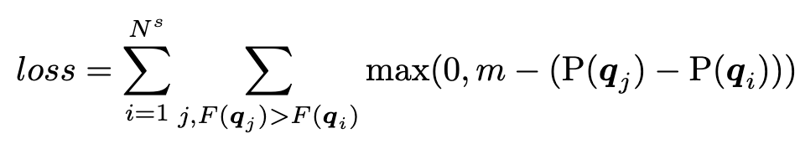
Predictor Training
Pair-wise ranking loss
Designed to drive the predictor to learn the relative ranking of difference model schedules.
Notes:
The authors decide that whether having accurate predictions of the actual FIDs for model schedules is not as important as being able to predict the ordering of the schedules.
The training round of the predictor is run for every pair of model schedules. The training uses a pair-wise ranking loss.
The high level idea is that for every pair of model schedule that has a clear ranking of generation quality, its contribution to loss will be big if the predicted ordering is reversed or the gap between the predicted FIDs is not big enough.
This way, the loss drives the predictor to learn the relative ranking of different model schedules.

Slide 13
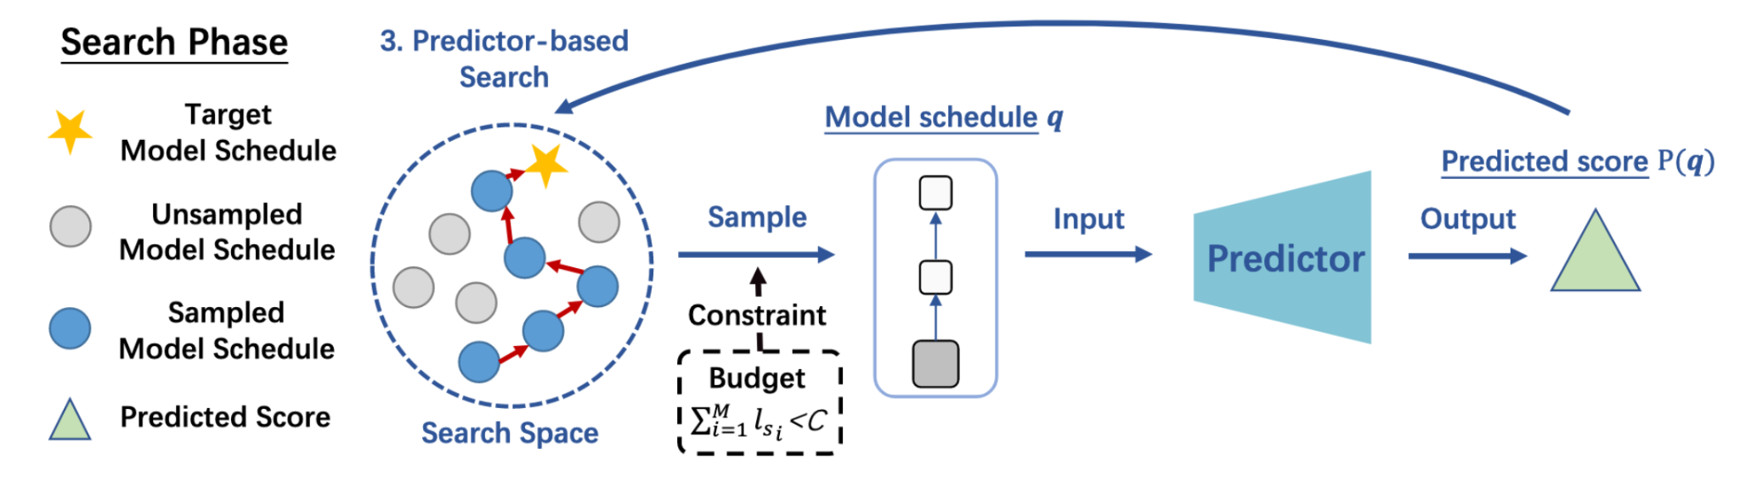
Predictor-Based Evolutionary Search
A simple evolutionary algorithm (Real et al., 2019) to find the best model schedule.
Other search algorithms might also work.
Real et al. Regularized evolution for image classifier architecture search. AAAI 2019.
Notes:
The predictor just predicts the generation quality of a model schedule. To figure out which model schedule is the best, we need to use search-based algorithm because it is impossible to run the predictor on all possible schedules.
A simple evolutionary algorithm is used in this paper. The high level idea is to start with a sampled schedule, derive more schedules by using different models at certain timesteps. If we consider each schedule as a node, then the derived schedules are the children of the node, and the entire search space should be a tree or graph. We would move from the starting node gradually towards schedules that have higher predicted scores and at the same time fulfill the latency constraint with the hope to find the global optimum schedule.
One thing to note is that the search phase is decoupled from the training of the predictor, so other search algorithm like simulated annealing, beam search, etc, should also work.

Slide 14
Approach Recap
Notes:
So to recap, given a group of pretrained models on a specific dataset, we first train a predictor that can output an FID score given an input schedule, and then use that predictor as a feedback to iteratively search for better schedules with the hope to find the globally optimal one.

Slide 15
Evaluation: Setup
Sec 5.1: Pixel Diffusion + DDIM/DPM-Solver
Dataset: CIFAR-10, CelebA, ImageNet-64, and LSUN-Church.
Model zoos: different model architectures.
Sec 5.2: Stable Diffusion + DPM-Solver
Model zoos: same architecture, but trained on different datasets with different parameters.

Slide 16
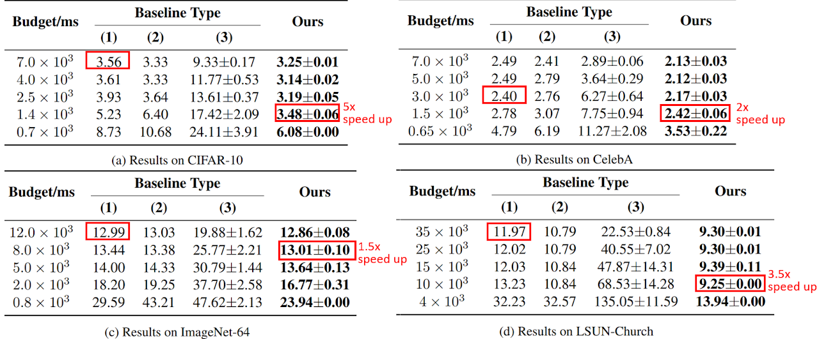
Evaluation
Notes:
This table shows the searched results on 4 datasets with DPM-Solver. Baseline (1) uses a single model across all timesteps. Baseline (2) is the model schedule with the best FID under budget constraint in the training set. Baseline (3) is a randomly generated model schedule under budget constraint.
First, we can see that baseline (2) outperforms baseline (1) in many cases, which means that mixing multiple models in the generation process is better than the current practice of using a single model. This shows the importance of model schedules.
Second, we see that OMS-DPM always outperforms baseline (2) and baseline (3) by a large margin. These benefits indicate that our predictor is able to generalize from the limited training set, and the search algorithm is able to find a better model schedule that outperforms the best one in the training set.
If we compare between different budgets, OMS-DPM can achieve an up to 5x speed-up without sacrificing generation quality.
The robustness of OMS-DPM across datasets, budgets, and samplers.

Slide 17
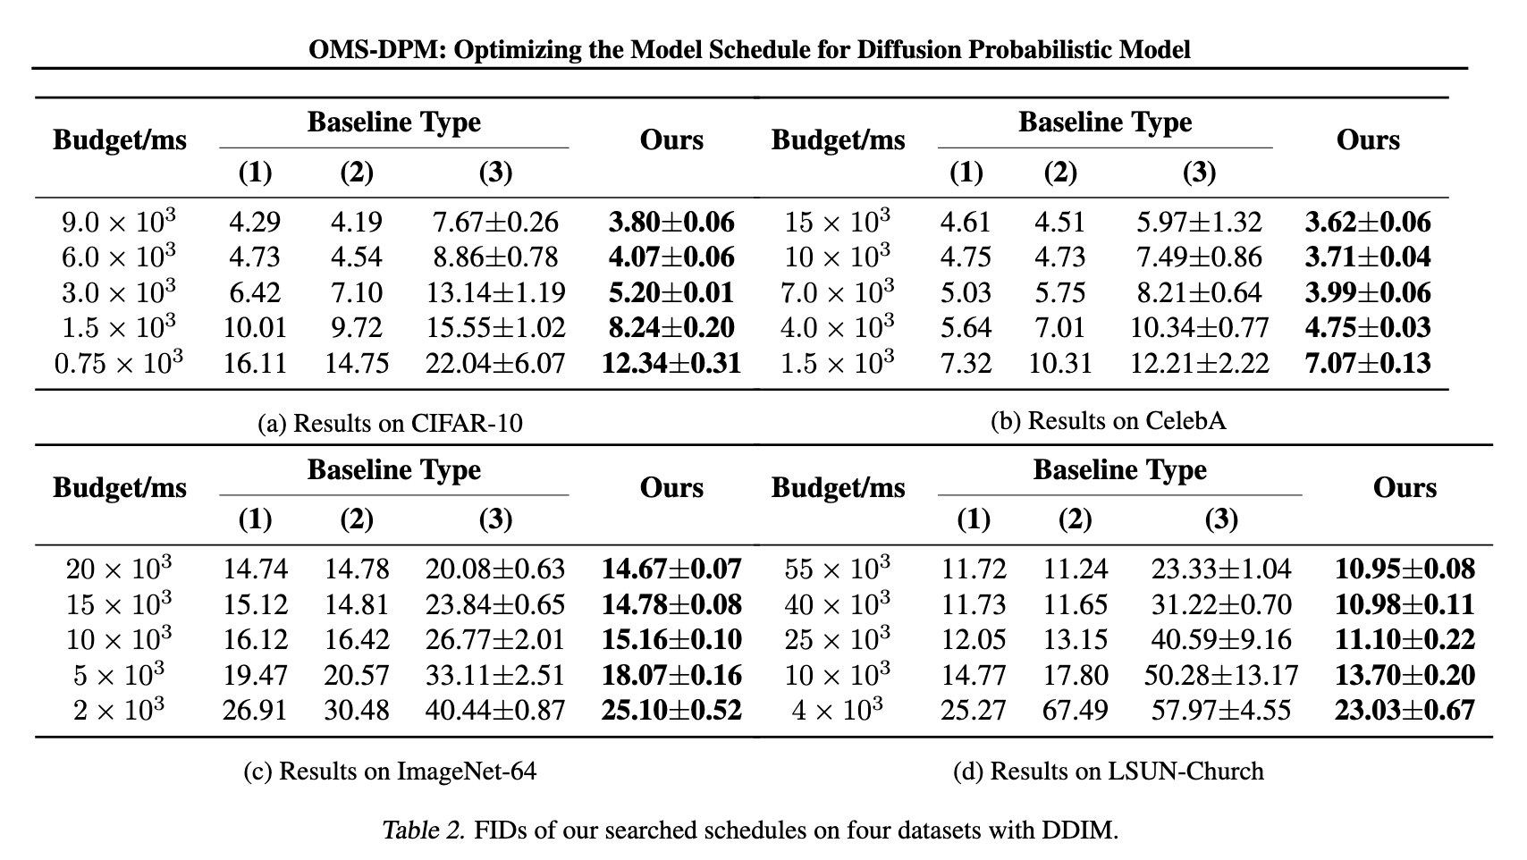
Evaluation
Notes:
This table shows the result with DDIM, which has similar conclusion with DPM-Solver on the last page.

Slide 18
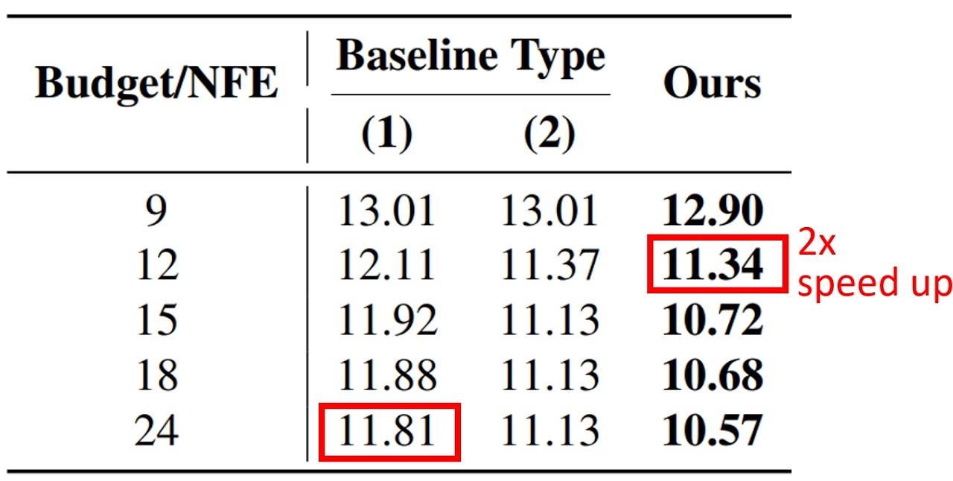
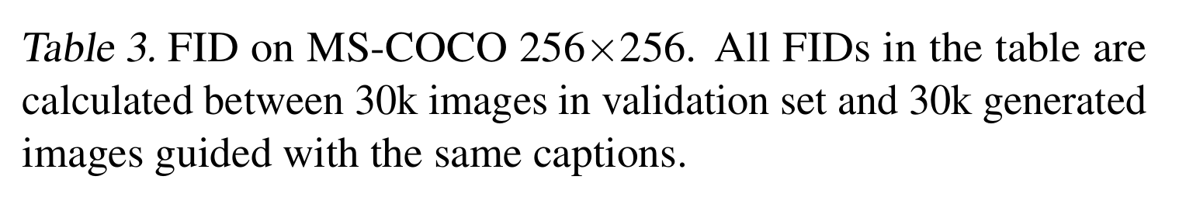
Evaluation
Notes:
On four official pre-trained stable diffusion models, the searched schedule can achieve also up to 2x speed-up over baselines. Note that the 4 checkpoints used here are from different training iterations of the same model. With the same architecture, mixing checkpoints from a single training process with OMS-DPM is also beneficial.

Slide 19
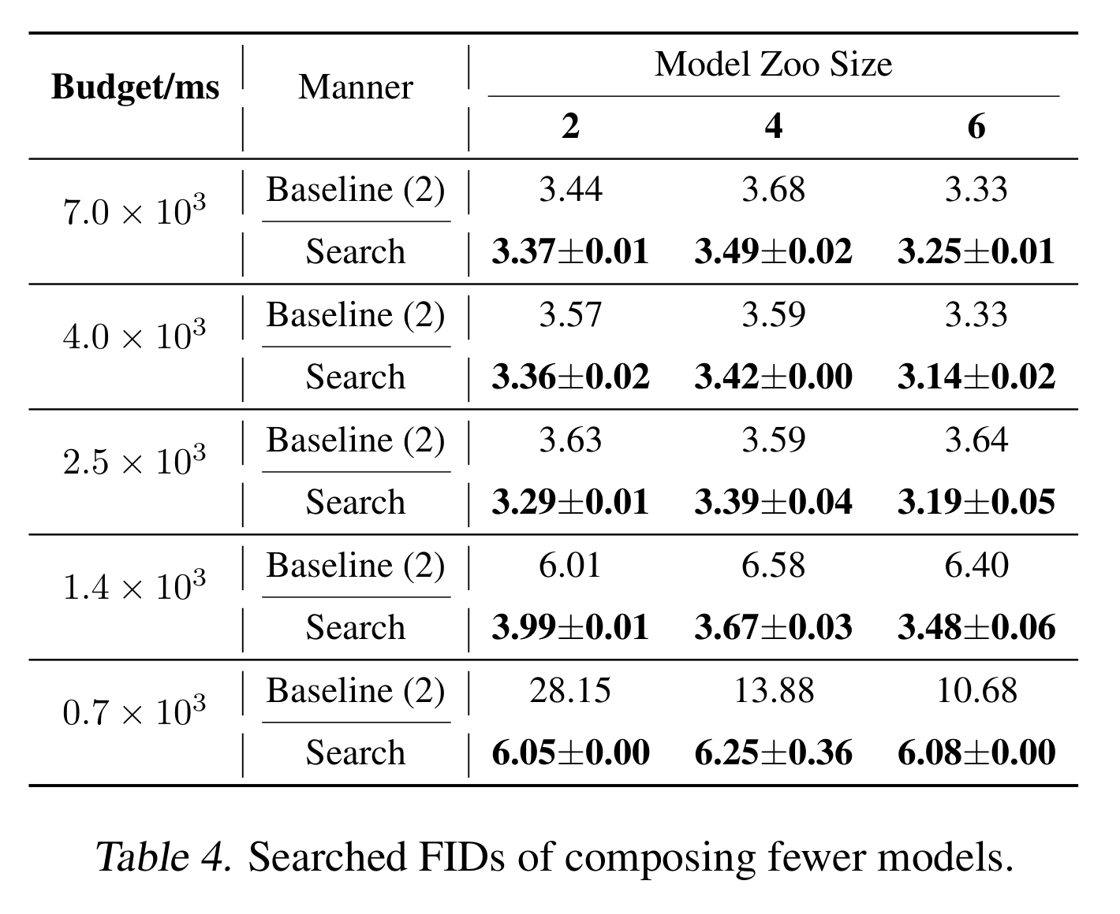
Ablation Study
Notes:
Tab. 4 shows the FID results of OMS-DPM with different model zoo sizes. We can see that using the largest model zoo with N = 6 achieves the best results, and we see an improvement over the baseline across all model zoo sizes. Nevertheless, the N = 2 results are slightly better than N = 4. One potential reason is that N = 2 induces a smaller search space, and thus OMS-DPM can explore the search space more sufficiently.

Slide 20
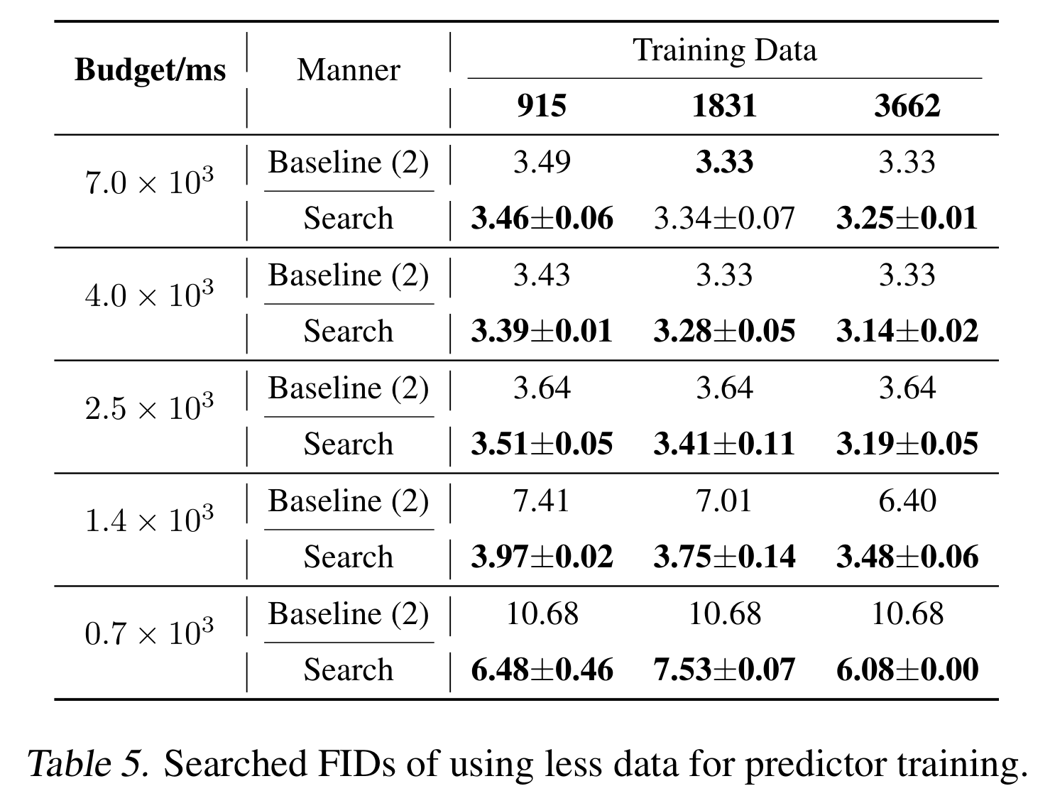
Ablation Study
Notes:
Tab. 5 shows the FID results using different data sizes for predictor training. Using less data to train the predictor results in degraded performances. But in all three cases, OMS-DPM still achieves better results than the baseline, indicating that it can make the predictor training phase more efficient while still obtaining promising results.

Slide 21
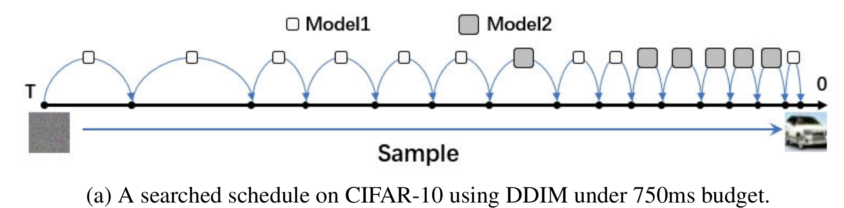
Empirical Observations
Under a low time budget, using smaller models with more steps is more likely to gain a better generation quality than using larger models with fewer steps.
Notes:
Here the authors also summarized some observations on the searched model schedule patterns. First, should we use more steps or larger models? Under a low time budget, using smaller models with more steps is more likely to gain a better generation quality than using larger models with fewer steps. The model schedules derived by OMS-DPM under the tightest budget are composed of only the 2 or 3 models with the lowest latency in the model zoo. For example, …
Conversely, when having an adequate time budget, using larger models is suggested.

Slide 22
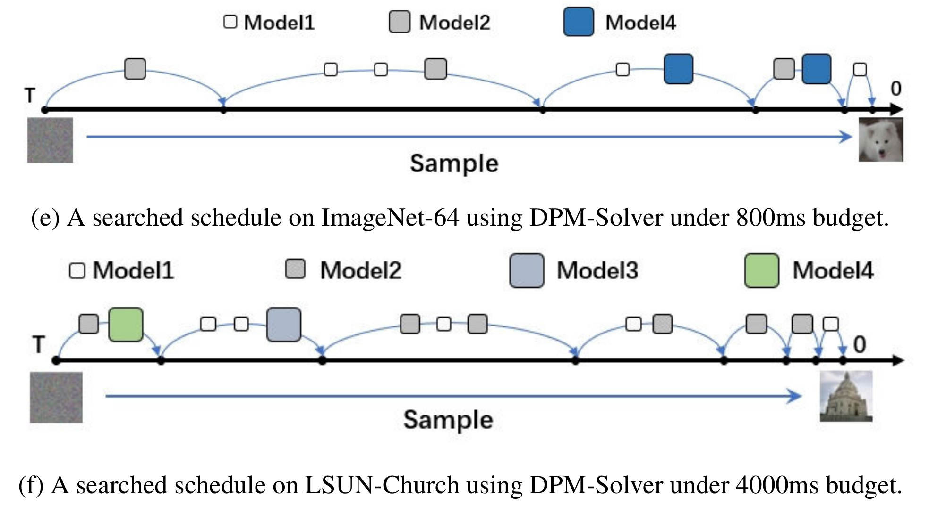
Empirical Observations
Using larger models near generated data improves performance on ImageNet-64 and CIFAR-10, while near-noise steps work better on LSUN-Church.
Notes:
Should we apply larger models earlier or later? On ImageNet-64 and on CIFAR-10 with DDIM, using large models at steps near the generated data is more likely to achieve better performances than using large models at steps near the noise. On LSUN-Church, the case is just the opposite. That is, using large models at steps near the noise is more likely to achieve better performances.

Slide 23
Empirical Observations
Under a low time budget, using smaller models with more steps is more likely to gain a better generation quality than using larger models with fewer steps.
Using larger models near generated data improves performance on ImageNet-64 and CIFAR-10, while near-noise steps work better on LSUN-Church.
Optimal DDIM step sizes increase near the final image on CIFAR-10, CelebA, and ImageNet-64, but vary on LSUN-Church.
DPM-Solver: prefer 1st/2nd under tight budgets, 3rd is only used under adequate budgets
Stable Diffusion: 3 solvers are mixed under all budgets
Notes:
How should the timestep be discretized?
Which solver order should be used?

Slide 24
Discussion
Strengths:
Proposed a new optimization angle - model schedule, orthogonal to system optimizations.
Solution components are largely modularized, allowing decoupled improvements.
Limitations:
Hard to extend to a new dataset or task.
Model zoo is manually constructed and trained
Theoretical analysis
Notes:
If given a new dataset or task, we need to prepare the predictor training data on that dataset or task and train a new predictor, which incurs a substantial overhead.
Model zoo is manually constructed and trained. It’s not very efficient and effective.
Theoretical analysis about when and why a DPM model favors certain denoising steps is limited.

Slide 25
Are More LM Calls All You Need? Towards the Scaling Properties of Compound AI Systems
Muyan Hu, Xin Xu, Jiachen Yuan

Slide 26
Background
Is there scaling law during inference?
Many recent SOTA results in LLMs are achieved with Compound System.
Compound System: performing multiple LM calls and aggregating responses.
E.g., Gemini Ultra employs a CoT@32 voting strategy.
How does scaling the number of LM calls affect the performance of compound system?
Start with Vote and Filter-Vote on multiple-choice questions.
Notes:
The scaling law is a widely used principle in training LLMs, e.g., Llama.
People attempt to answer the question from different perspectives. The Compound System seems to be a promising direction.
To answer the question, the authors start with simple compound system, i.e., vote and filter-vote, on simple tasks, i.e., multiple-choice questions.

Slide 27
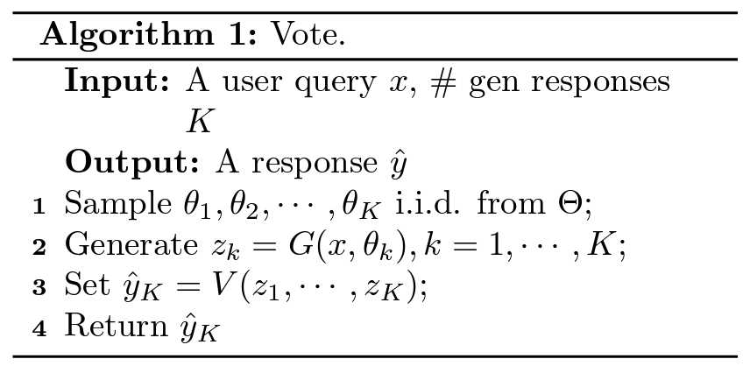
Background: Vote
Vote: self-consistency, MedPrompt, Gemini CoT@32, …
Create candidate answers by calling the generator;
Use the majority voter to choose the final answer.
Notes:
In this paper, the authors examine two commonly-used compound system: Vote and Filter-Vote.
Vote is used in compound AI system including self-consistency, Medprompt, Gemini CoT@32.

Slide 28
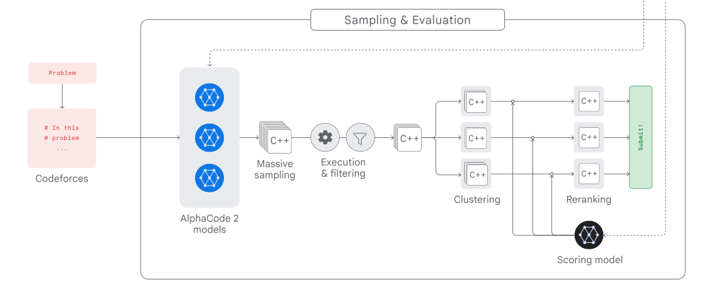
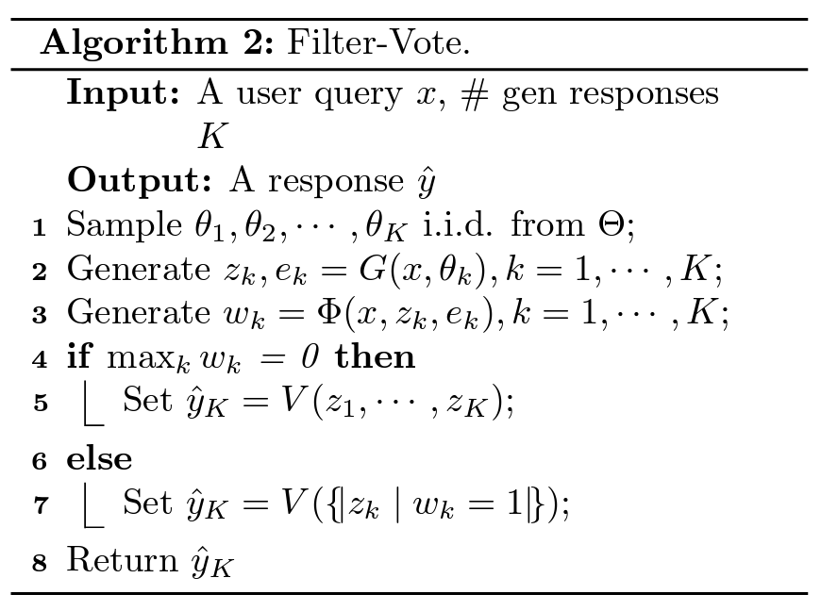
Background: Filter-Vote
Filter-Vote: AlphaCode2, AlphaGeometry.
Generate multiple candidate answers;
Remove a few candidate answers by the filter;
Use the majority voter to choose one from the remaining answers.
AlphaCode2
Notes:
AlphaCode2: The filter eliminates 95% of the samples (millions). The scoring model acts like a majority voter.

Slide 29
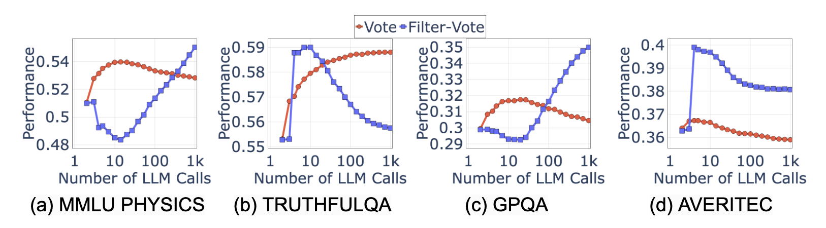
Non-monotonic Scaling Behavior
Observation: The performance might be a non-monotonic function of LM calls.

Slide 30
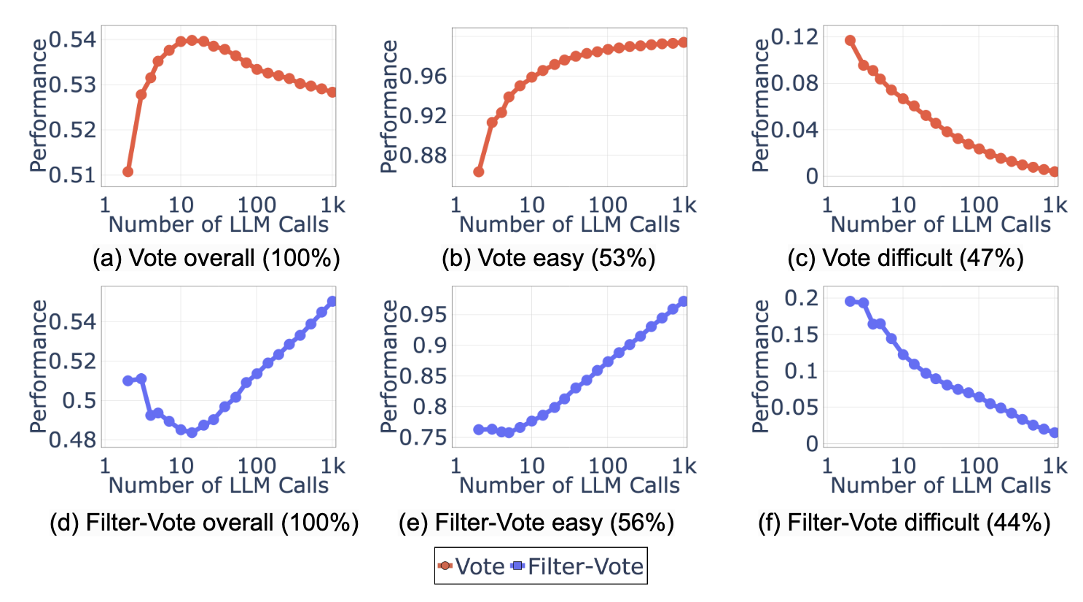
Query Difficulty-based Explanation
Key insight: Individual query difficulty is crucial in LM calls’ effects.
Consider simple query, difficult query separately.
Notes:
Law of large number

Slide 31
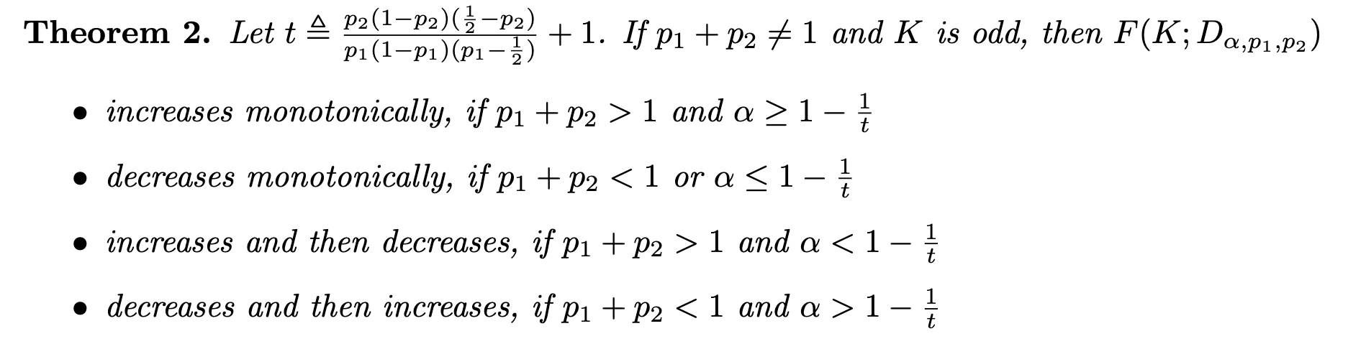
Query Difficulty-based Explanation
A more rigorous analysis: F(K,D) denotes the accuracy with K LM calls per query on D.
Consider a specific dataset with 2 possible answers (for each query), where
α queries with correctness p1>1/2, 1-α queries with correctness p2<1/2;

Slide 32
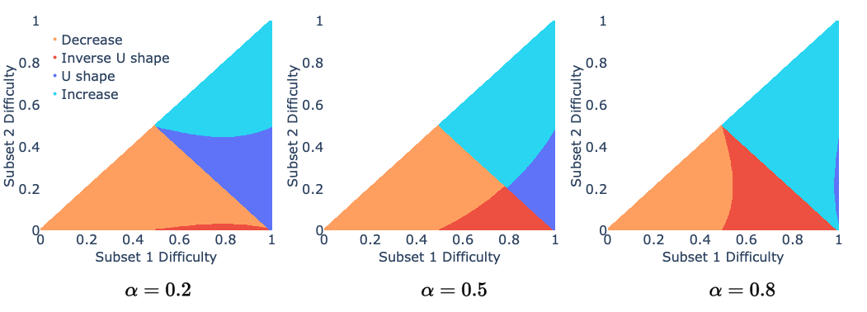
Query Difficulty-based Explanation
Consider a specific dataset with 2 possible answers (for each query), where
α queries with correctness p1>1/2, 1-α queries with correctness p2<1/2;
Notes:
If the overall task is “easy” (p1 + p2 > 1), but the fraction of “hard” queries is large (α < 1 − 1 / t), then as the number of LM calls increases, the Voting Inference Systems’ performance increases first but then decreases.
If the overall task is “hard” (p1 + p2 < 1), but the fraction of “hard” queries is small (α > 1 − 1 / t), then enlarging the number of LM calls leads an initial decrease and then increase.
When α is large, the U-shape is less likely to occur while the inverse U-shape becomes more common. Smaller α leads to an opposite trend.

Slide 33
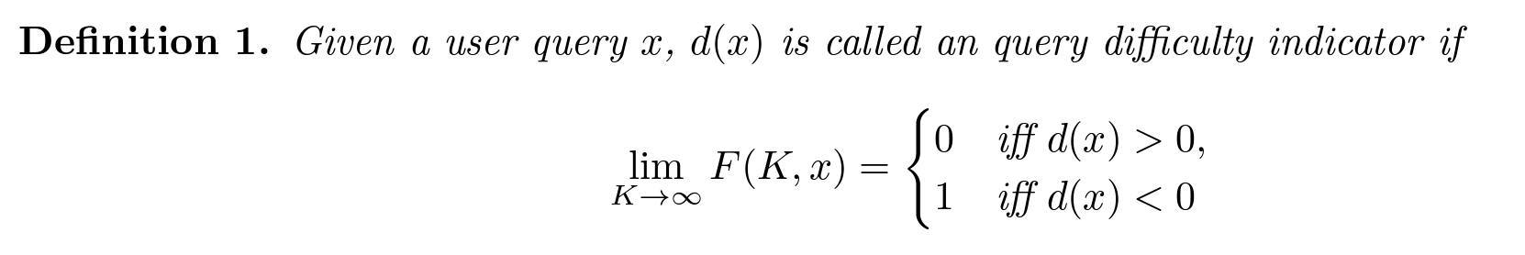
Heuristic for Optional Number of LM Calls
What is the analytical scaling model, i.e., F(K,D)?
In rare cases (previous example), we have closed-form solution.
Notes:
For the whole dataset, perform average on all samples.

Slide 34
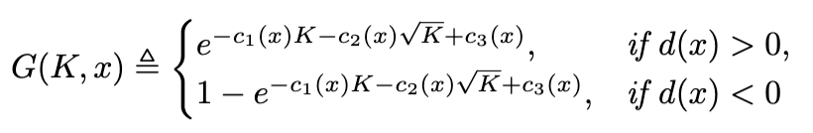
Heuristic for Optional Number of LM Calls
How about Filter-Vote and the general answer space? Do approximation!
F(K,x) should be treated separately for difficult and easy queries;
Ix(a,a) grows roughly exponentially in x.
In practice, use training dataset to fit the parameters in G(K,D).
Then use argmax_K G(K,D) to obtain the optimal number of LM calls.
Notes:
G(K;D) is the Analytical Performance Model to approximate F(K;D).

Slide 35
Experiments: Datasets and LM
MMLU PHYSICS: high school physics questions;
TRUTHFULQA: truthfulness in generating answers to questions;
GPQA: queries generated by experts in biology, physics, and chemistry;
AVERITEC: claims (to verify the correctness);
Each query is prompted as a multiple-choice question for evaluation.
Vote: through prompts, temperature, sampling, …
Language Model: GPT-3.5-turbo-0125.

Slide 36
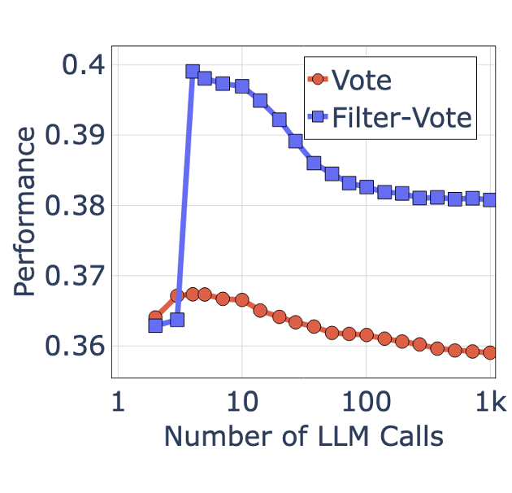
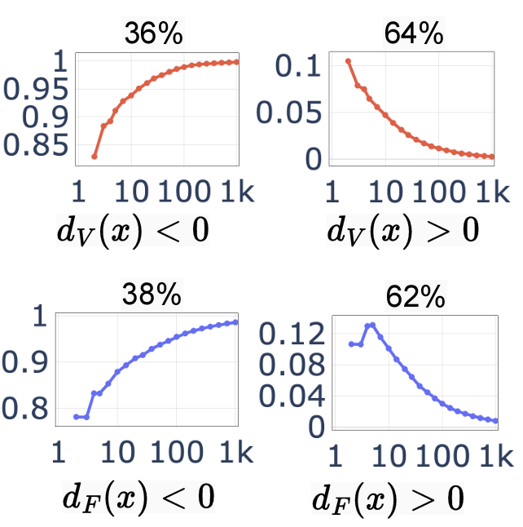
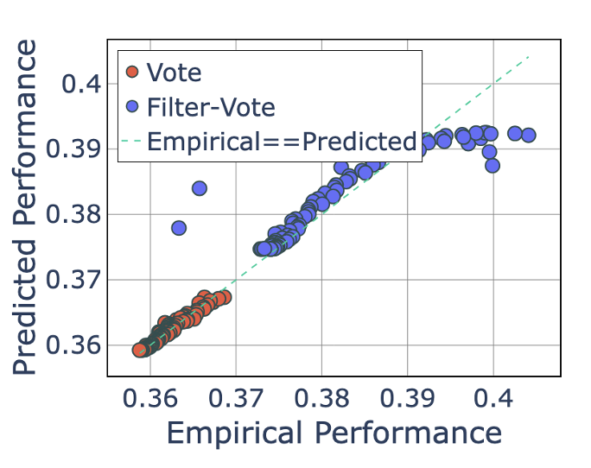
Experiments: AVERITEC
Non-monotonic Scaling Behavior
Individual Query Difficulty
Fit with 2, 5, 10, 20, 50, 100 LM calls

Slide 37
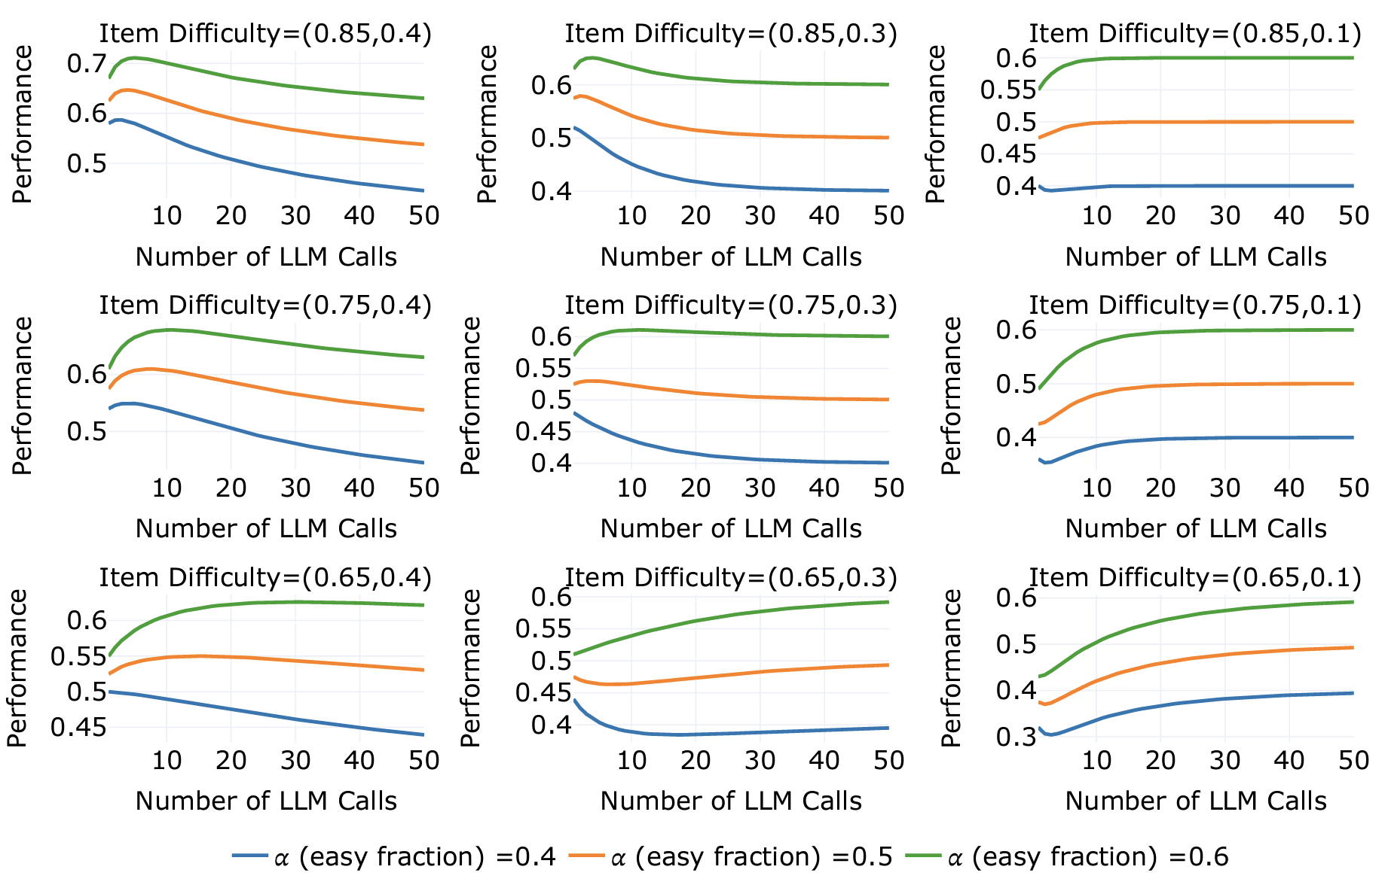
Experiments: Synthetic
Overall performance of one-layer Voting Inference Systems on synthetic datasets with bilevel difficulty: Increasing the number of LM calls does not necessarily lead to performance improvements.

Slide 38
Summary
Takeaway Messages:
More LLM Calls does not always improve performance.
The compound system is highly sensitive to data.
Limitations:
Only consider multiple choices; hard to generalize to other output formats.
Fitting is done on the entire dataset, reducing generalization in applications.
“Cheat” on benchmarking, not producing better results.

